Slide 1




Chapter 17: Analysis and Interpretation: Individual Variables Independently

Slide 2
Learning Objectives
Distinguish between univariate and multivariate analyses
Describe frequency analysis
Describe descriptive statistics
Discuss confidence intervals for proportions and means
Overview the basic purpose of hypothesis testing

Slide 3
Data Analysis: Two Key Considerations
(1) Is the variable to be analyzed by itself (univariate analysis) or in relationship to other variables (multivariate analysis)?
(2) What level of measurement was used?
If you can answer these two questions, data analysis is easy…

Slide 4
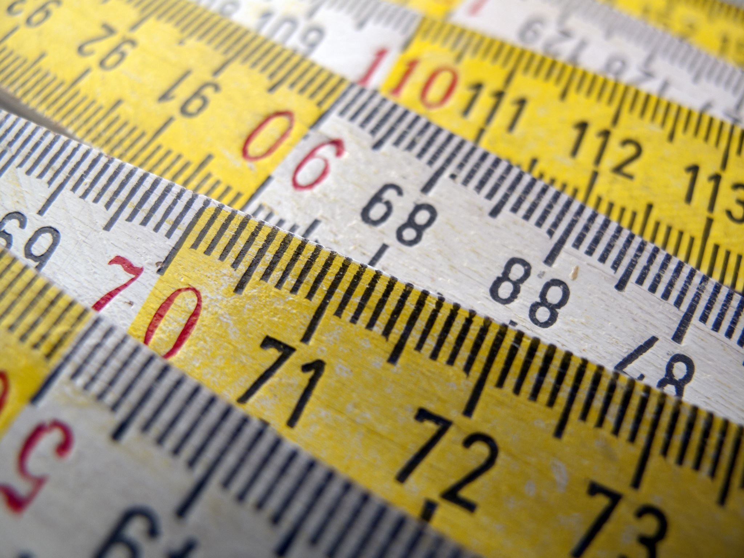
Measures
Categorical Measures
A commonly used expression for nominal and ordinal measures
Continuous measures
A commonly used expression for interval and ratio measures

Slide 5
The Avery Fitness Center (AFC) Project
Research Problems:
(1) discover existing member demographics and usage patterns (including fees paid)
(2) investigate how members initially learn about AFC
Population: AFC members who had visited AFC at least once in the prior 12 months
Simple random sample
Mail survey; 231 suable responses (58% response rate)
Primary data matched to secondary data (i.e., fees paid over prior 12 months)

Slide 6

Basic Univariate Statistics: Categorical Measures
Frequency Analysis
A count of the number of cases that fall into each of the possible response categories
An incredibility common and useful type of analysis

Slide 7
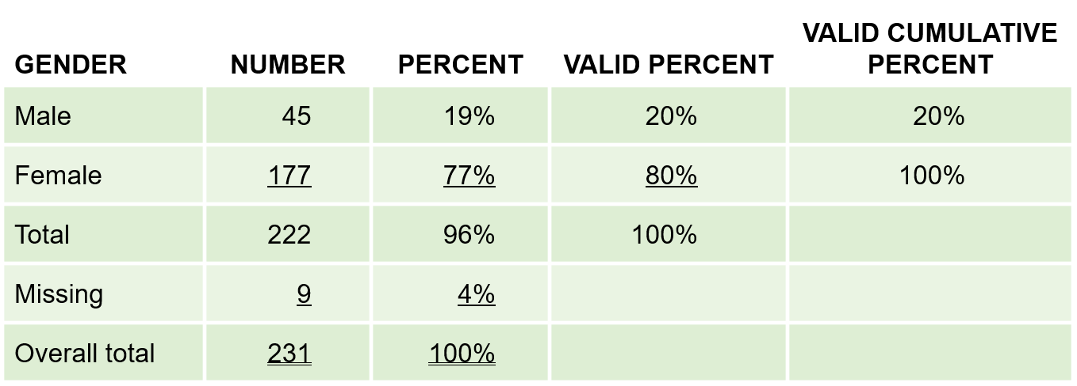
The Avery Fitness Center (AFC)
Exhibit 17.1 Avery Fitness Center: Gender

Slide 8
Use of Percentages
Percentages are very useful for interpreting the results of categorical analyses and should be included whenever possible
Unless your sample is VERY large; however, report percentages as whole numbers (i.e., no decimals)

Slide 9
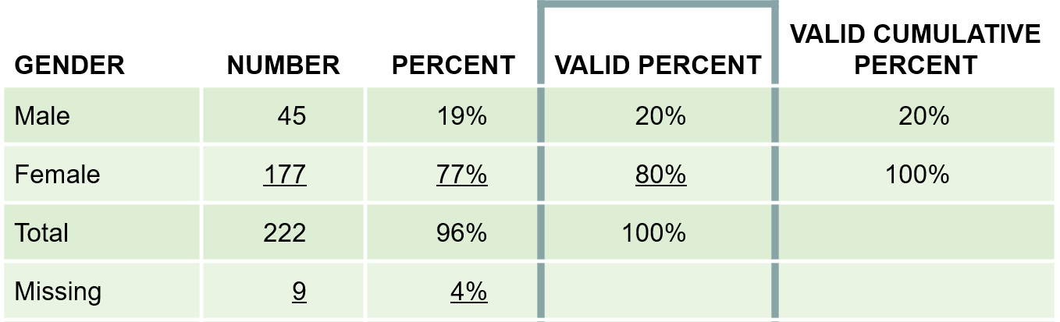
Frequency Analysis
Researchers almost always work with “valid” percentages which are simply percentages after taking out cases with missing data on the variable being analyzed
Exhibit 17.1 Avery Fitness Center: Gender

Slide 10
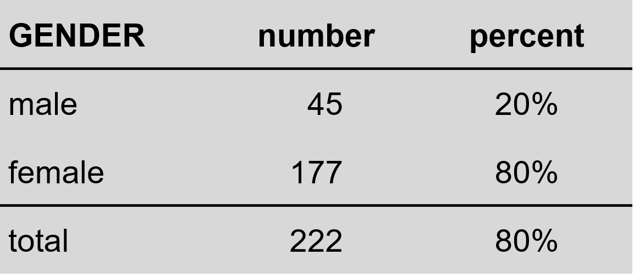
Presenting Frequency Analysis Results
(missing = 9)

Slide 11
Uses of Frequency Analysis
Univariate categorical analysis
Identify blunders and cases
Identify outliers
Outlier: an observation so different in magnitude from the rest of the observation that the analyst chooses to treat it as a special case
Identify the median

Slide 12
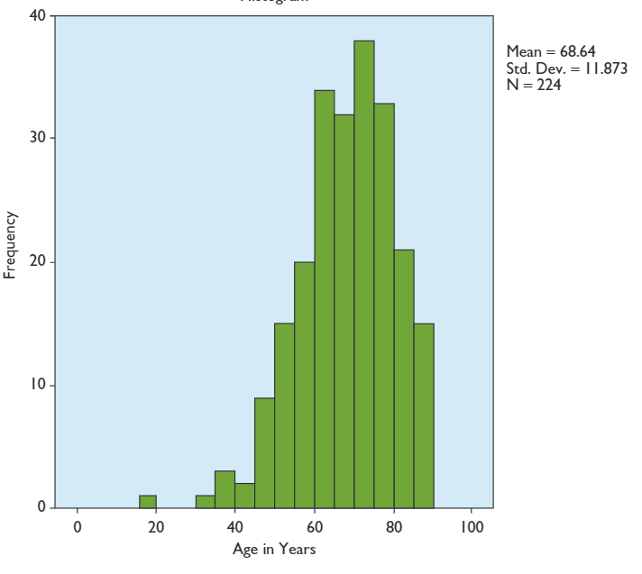
Uses of Frequency Analysis

Slide 13

Uses of Frequency Analysis
Histogram
A form of bar chart on which the values of the variable are placed along the x-axis and the absolute or relative frequency of the values is shown on the y-axis

Slide 14
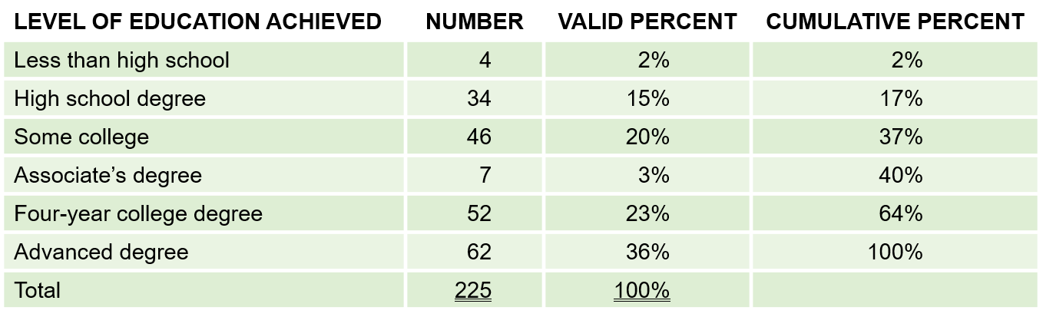
Uses of Frequency Analysis
Exhibit 17.2 Avery Fitness Center: Level of Education
The MEDIAN level of education is found by identifying the level that contains the 50th percentile in the frequency distribution.

Slide 15
Converting Continuous Measures to Categorial Measures
Sometimes it is useful to convert continuous measure to categorical measures
This is legitimate because measures at higher levels of measurement (in this case, continuous measures) have all the properties of measures at lower levels of measurement (categorical measures)
Why do this? Ease of interpretation

Slide 16

Common Approaches
Common Approaches:
Judgment
Median split
Cumulative % breakdowns
Two-box technique

Slide 17
Median Split
A technique for converting a continuous measure into a categorical measure with two approximately equal sized groups. The groups are formed by “splitting” the continuous measure at its median value

Slide 18

Common Approaches
The MEDIAN level of education is found by identifying the level that contains the 50th percentile in the frequency distribution
Exhibit 17.2 Avery Fitness Center: Level of Education

Slide 19
Common Approaches
Using a median split will result in two education groups, a lower education group (64%; less than high school, high school degree, some college, associate’s degree, four-year college degree) and a higher education group (36%; advanced degree).
An alternative approach that would produce a more even split of AFC respondents would be to combine those with a four-year or advanced degree as the higher education group.

Slide 20
CUMULATIVE PERCENTAGE BREAKDOWN
A technique for converting a continuous measure into a categorical measure. The categories are formed based on the cumulative percentages obtained in a frequency analysis.

Slide 21
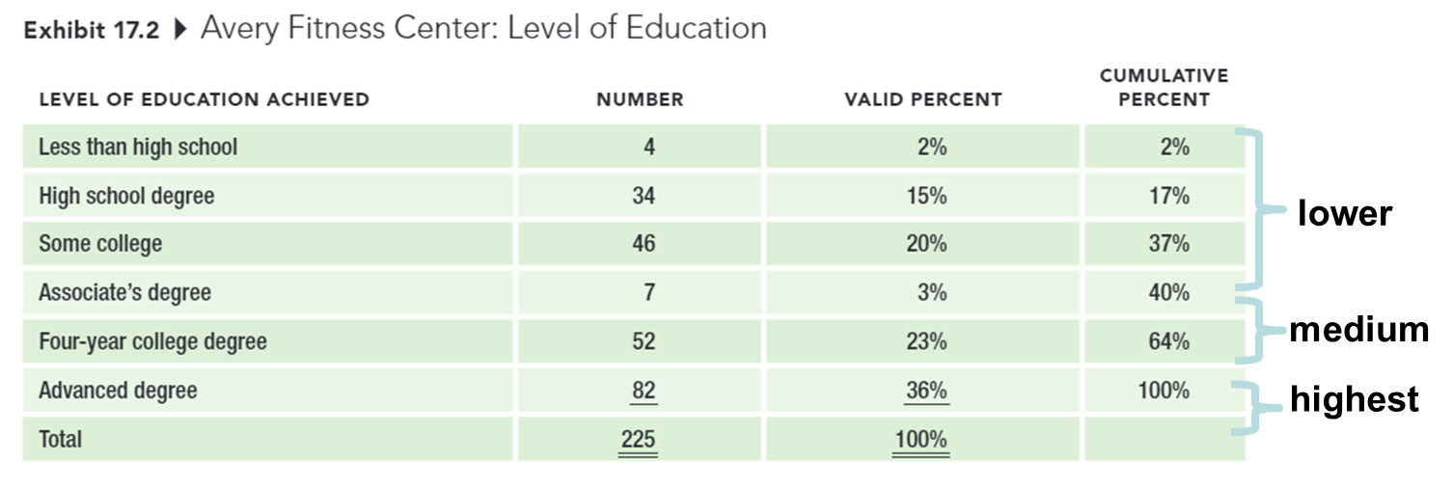
CUMULATIVE PERCENTAGE BREAKDOWN
Notes:
If we wanted three approximately equal-sized education groups instead of six, we could use the cumulative percentage breakdown to construct the groups.

Slide 22
TWO-BOX TECHNIQUE
A technique for converting an interval-level rating scale into a categorical measure, usually used for presentation purposes. The percentage of respondents choosing one of the top two positions on a rating scale is reported.

Slide 23
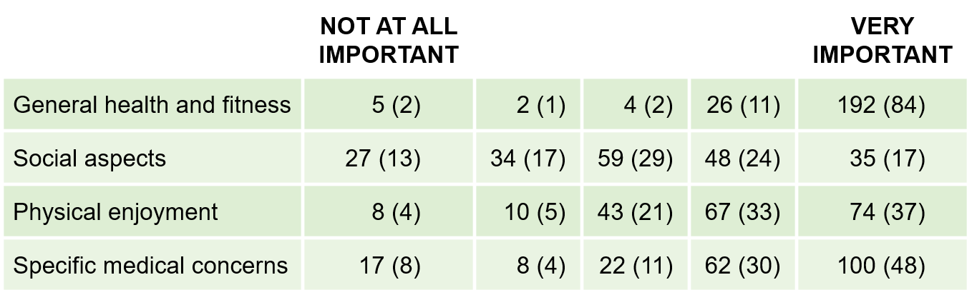
TWO-BOX TECHNIQUE
Exhibit 17.6 Avery Fitness Center: Reasons for Participation “How important to you personally is each of the following reasons for participating in AFC programs?”
Number (Percentage) of Respondents Selecting Each Response Category

Slide 24
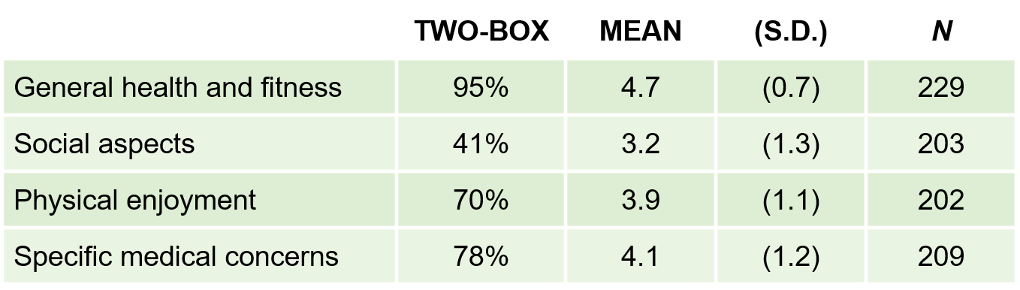
TWO-BOX TECHNIQUE
Exhibit 17.7 Avery Fitness Center: Two-Box Results, With Descriptive Statistics

Slide 25
Simple Regression

Slide 26
Assignment 7: Mid-semester Peer Evaluation

Slide 27
5-min snippet

